Slide 1
Mayhem at DinoFunWorld: Visitor Movement
Ian O’Keeffe

Slide 2
Preprocessing

Slide 3
Goals
Visitor movement data is in extremely high demand for theme parks. In 2013, Walt Disney World released MyMagic+, a project that cost the company $2 billion dollars, and who’s main purpose was tracking guest movement. For context, the two most recent US Disney parks, Disney’s Animal Kingdom and Disney’s California Adventure, cost the company a total of $1.6 COMBINED.
Track visitor movement
Identify visitor clusters
Track Trends Across the Weekend

Slide 4
Data Overview
Variables
Visitor ID
X Coordinate
Y Coordinate
Event Type (check-in or movement)
Timestamp
Data
26,021,962 rows
11,374 Unique Ids
X and Y coordinates ranged from 0-100

Slide 5
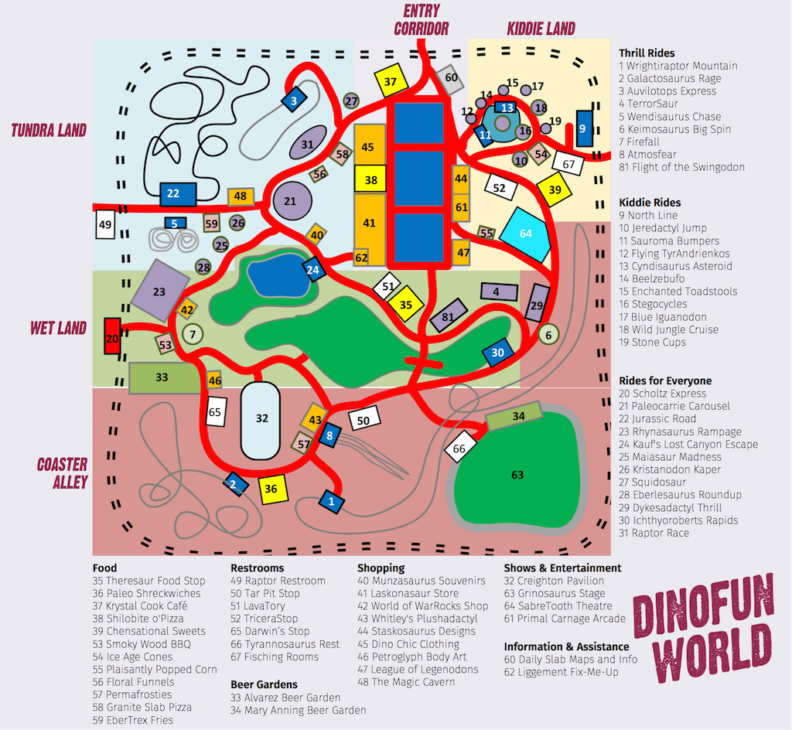
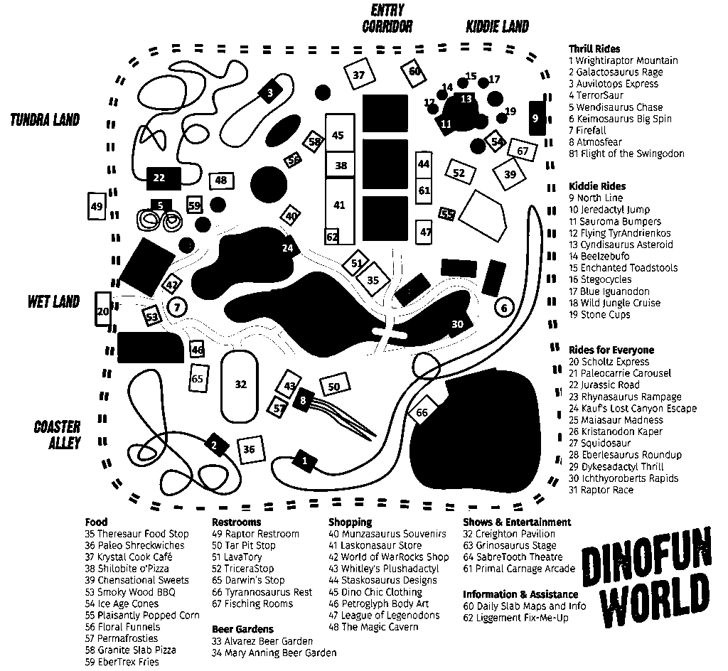
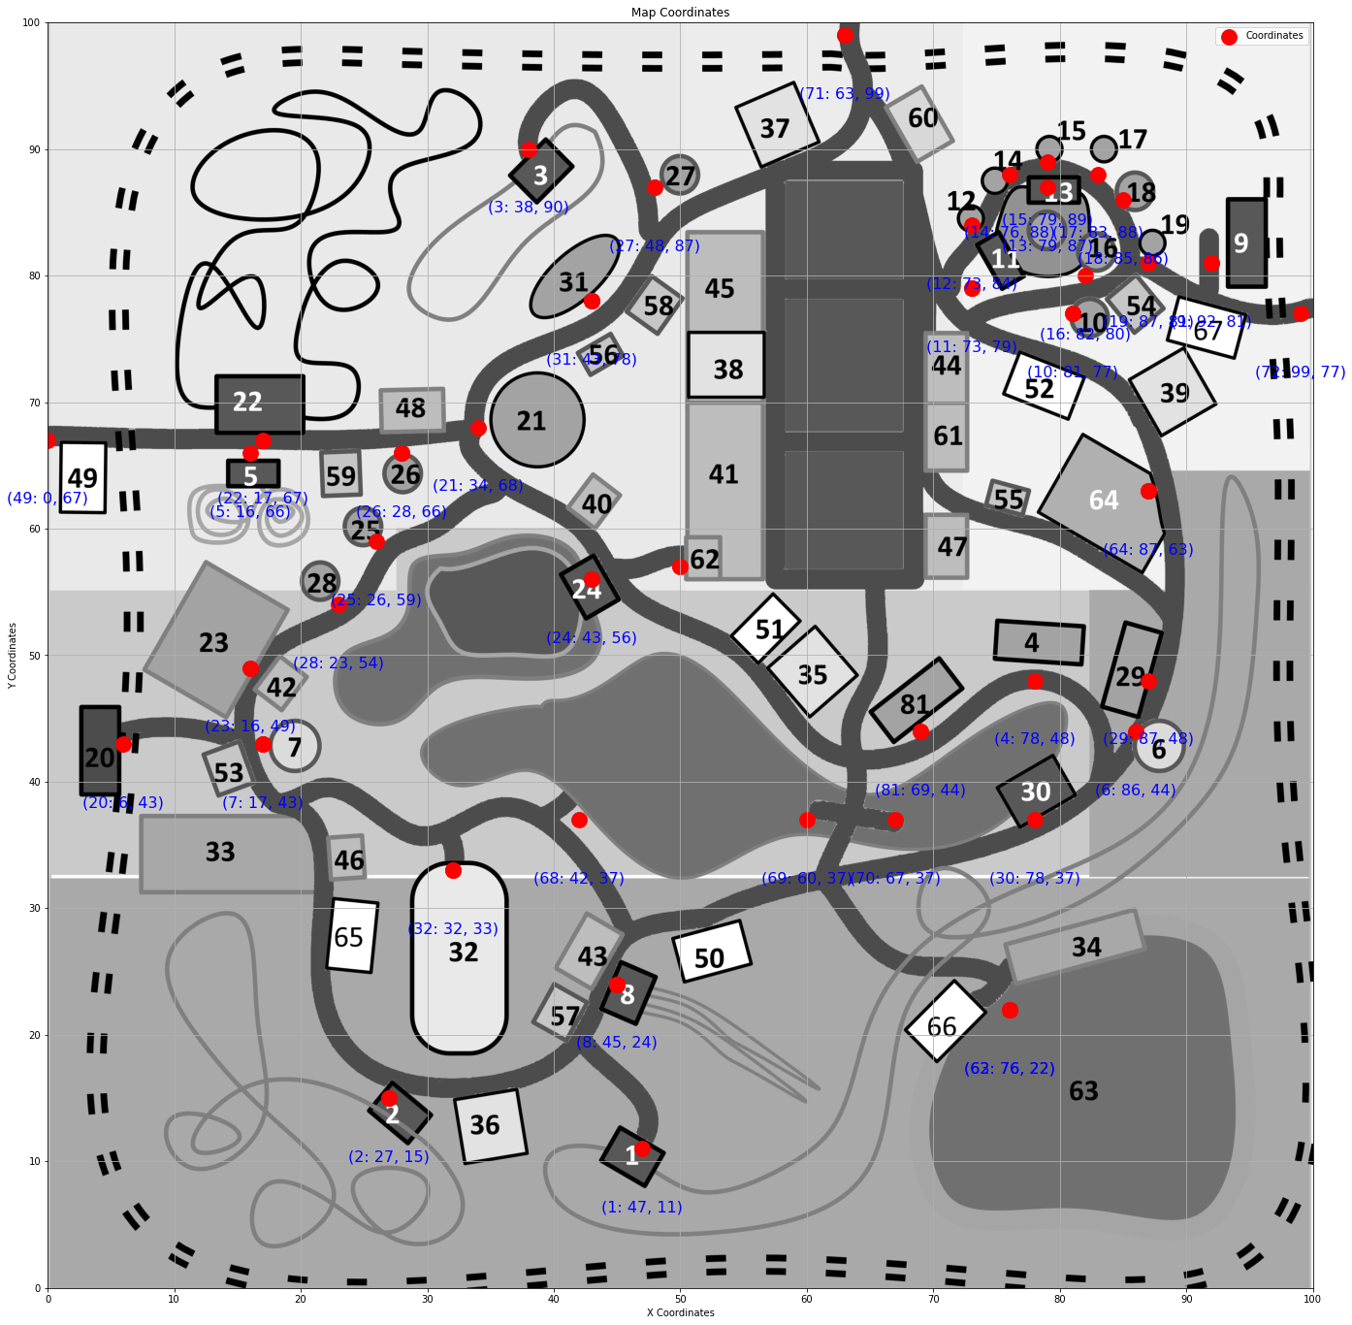
Data Preprocessing
Original Park Map with Ride Locations
B & W image with high contrast
Reprocessed image with location coordinates

Slide 6
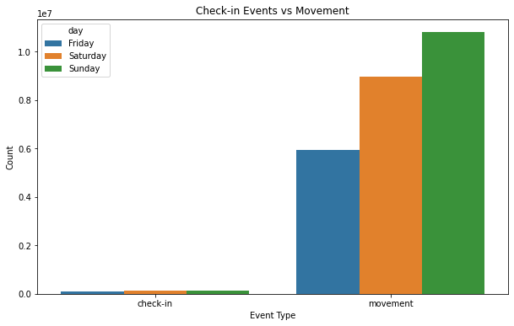
Event Types by Day

Slide 7
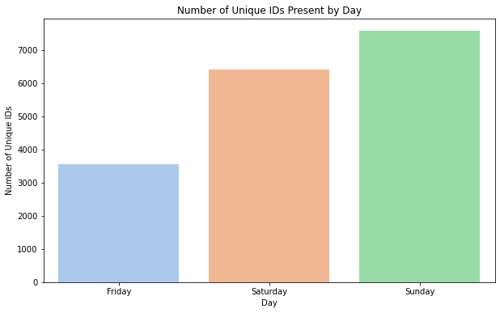
Visitor Count by Day
Notes:
We can already see the distribution is abnormal with things like instrumentalness, liveness, and tempo

Slide 8
Resulting Dataframes
Visitor ID dataframe
Each row represents a unique combination of visitor and day
Count number of visits to each attraction type
Get total time spent in park that day, as well as entry and exit time
Event Dataframe
Map X, Y coordinates on events to locations if it is a check in event
Group check in events by ID and by Day
Give each event a location name and location type to analyze
Movement Dataframe
4 dataframes, one for each day as well as full weekend.
Random Samples of 500 visitors each day.

Slide 9
Solving the Case

Slide 10
Suspicious Visitor
On both Saturday and Sunday, there were users who had movement events, and never checked in to the park entrance / exit, indicating that they snuck in.
Visitor Id #657863 went to the park on Friday, checked in at the entrance, and then spent 5 hours moving around but never checking into any rides. While some people don’t go on rides, there were only 22 of them across all visitors.
The same visitor had movement events Saturday, but no checkins. The movement events stopped suddenly while they were still in the park, not at an exit. Since the movement is tracked theoretically by phone data, this is a red flag.

Slide 11
Movement Analysis

Slide 12
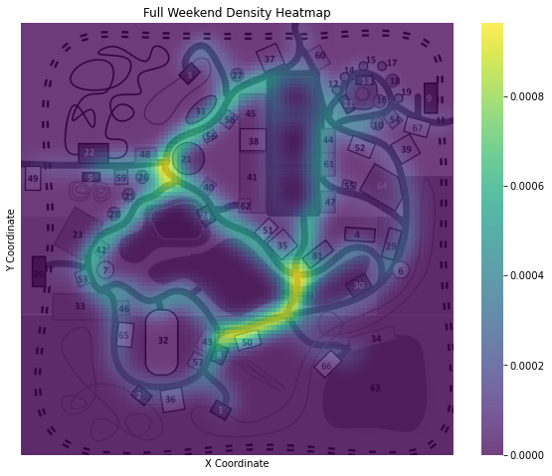
Density Heatmap
A Gaussian KDE was used to create the heatmap.
The two hotspots are in junction areas, where many guests traveling through the park would pass on the way to somewhere else
Other than a store at location 48, there are no Food/Beverage or Stores in these areas despite plenty of available room.

Slide 13
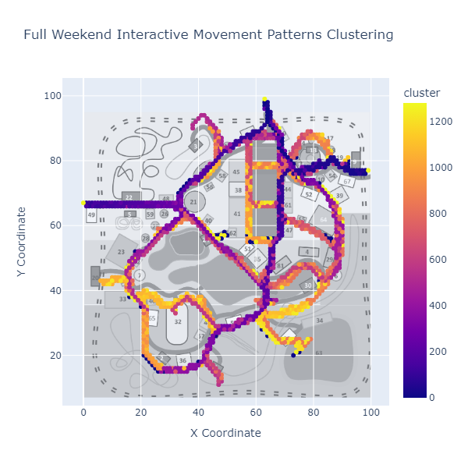
Visitor Movement Clusters
DB Scan to analyze clusters of visitor movement.

Slide 14
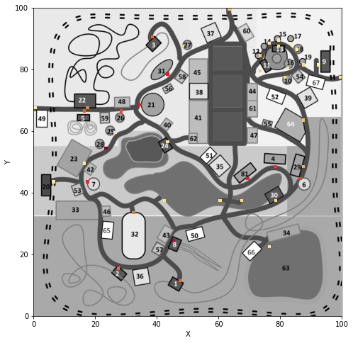
Heatmap by location
Only 42 of the 69 locations on the park map had sensors for check in events. No store, food/beverage location, or restroom had check-in events. Some shows did not either.

Slide 15
Attraction Data

Slide 16
Checkins by attraction and attraction category
Attraction Type | Attraction Name | Total Check-ins
Thrill | Keimosaurus Big Spin | 19077
Thrill | Galactosaurus Rage | 19075
Thrill | Auvilotops Express | 19024
Thrill | Wrightiraptor Mountain | 18990
Thrill | Atmosfear | 18596
Thrill | Flight of the Swingodon | 16355
Thrill | Firefall | 16269
Thrill | Wendisaurus Chase | 15851
Thrill | TerrorSaur | 14692
Show | Creighton Pavilion | 11394
Attraction Type | Total Check-ins
Thrill | 157929
Everyone | 64679
Kiddie | 42527
Show | 24804

Slide 17
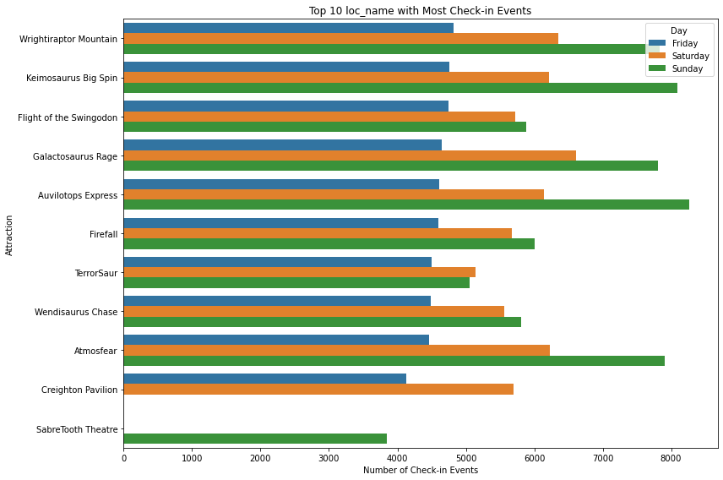
Attraction Popularity by Day
Creighton Pavillion, where the crime occured, was closed Sunday.
Sabretooth Theater is extremely popular but was only open on Sunday

Slide 18
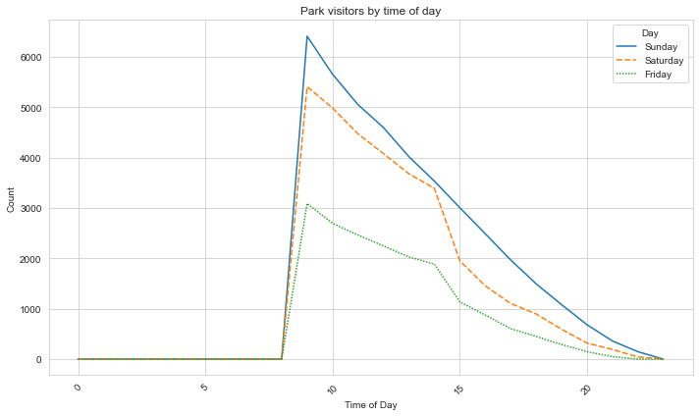
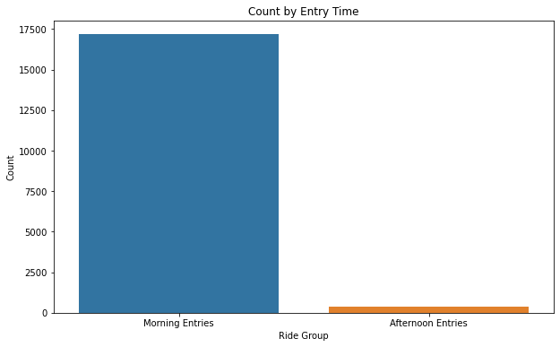
Visitors by Time of Day
To drive attendance, a discounted Afternoon ticket is a good recommendation. The park is at less than 50% of their peak by 3PM, but stays open until 10.

Slide 19
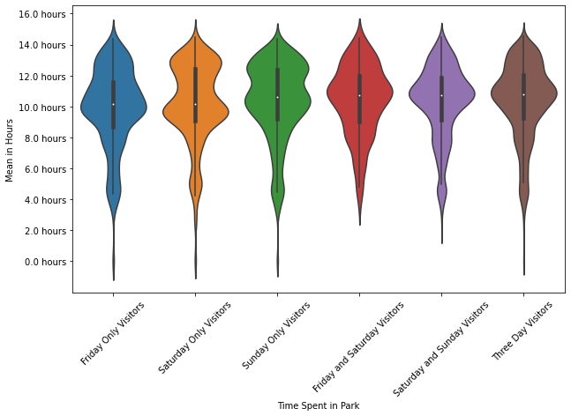
Time spent by Attendance
There is very little variation, which is notable - Three Day Visitors spend just as much time in the park as single day visitors, indicating strong brand loyalty.

Slide 20
Difficulties
The Dataset was so large that an incorrect merge on two dataframes would crash my computer
The clustering took a very long time, over an hour in some cases due to the size
Aligning the park map with different spatial data was hit and miss, as sometimes the image or plot would come out inverted on one axis.

Slide 21
Conclusions
The most likely culprit for the crime is guest #657863 due to the abnormal behavior
There are plenty of opportunities to increase guest spending by opening new restaurants and shops in high-trafficked areas
The park consistently bleeds attendees over the course of the day, with almost no visitors entering after noon. This should be looked into.
Thrill rides are far and above the major appeal to guests. The top 9 attractions are the 9 thrill rides. If attendance lags in the future, a new thrill ride would seem to fit guest trends.
The park movement tracking should be linked to the sales tracking to provide check-in events at refreshment and store locations.

